Slide 1


Slide 2

Clean Pakistan App
Supervised by:
Mam Mehreen Wahab
Group Members:
Muhammad Arshad(FA19-MCS-003)
Baqir Ali(FA19-MCS-022)
Department of Computer Science
COMSATS University Islamabad, Attock Campus

Slide 3
Outline
Introduction
Working flow
Problem statement
Interfaces
Objectives
Methodology
Modern tools
Benefits
References
_______________________________

Slide 4
Introduction
Pakistan generates about 48.5 million tons of solid waste a year, which has been increasing more than 2 percent annually.
Garbage causes many diseases in our society. They are categories into two category long-term Such as cholera epidemics, Kidney and liver damage, Nervous system damage, and neuromuscular blockage similar diseases.
The "clean Pakistan" app is introduced to cope with this problem.
If any citizen sees garbage anywhere, he will send the location and photo of the place to TMA. If the TMA already appointed the employee for this area then they take notice of their employee laziness and ensure that this problem can't appear in the future.
If a citizen wants to provide his services as an employee, he can do so. The "clean Pakistan" app provides the facility to register themselves to provide services in those areas where TMA does not access to clean those areas.
_______________________________

Slide 5
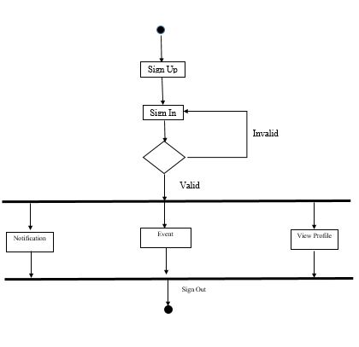
Working Flow For Employee
_______________________________

Slide 6
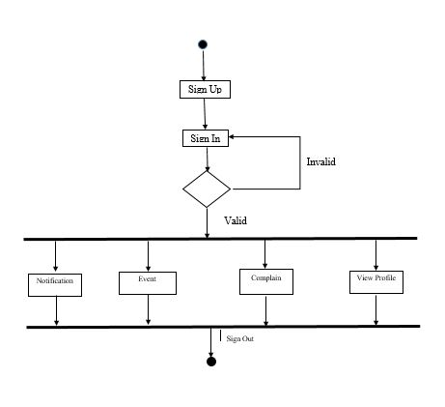
Working Flow For Volunteer
_______________________________

Slide 7
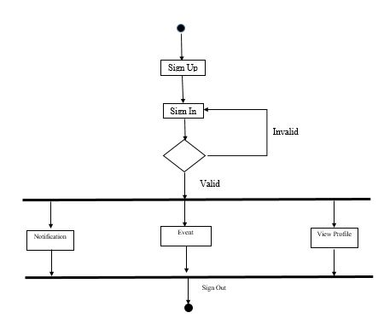
Working Flow For TMA Chairman

Slide 8
Problem statement
Sanitation is a big and important issue in our country. There are piles of garbage lying in every street for many days. The government and the citizens do not pay attention to the way garbage is causing various diseases in their lives.
The government has taken various steps to eradicate garbage. But more work is needed because the government employee does not do their duties according to the expectation of the public
People do not have any awareness of cleanliness because the illiteracy level high they have no internal discipline to properly manage the garbage.
Q.1. How to check the work of TMA employees?
Q.2. How a Volunteer can play his role?
Q.3. How to aware public for this issue?
Q.4. How to improve coordination between government, volunteers and public?
_______________________________

Slide 9
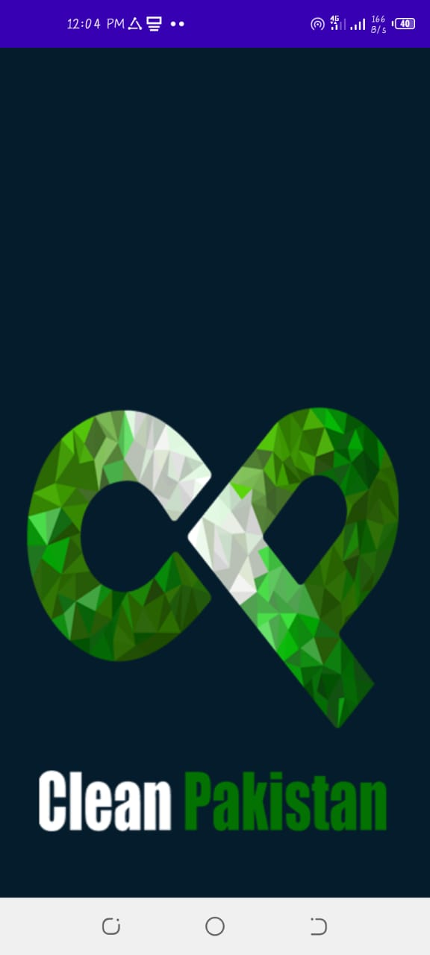
Interfaces
Splash Screen: When You will open the application the splash screen will be shown like this.

Slide 10
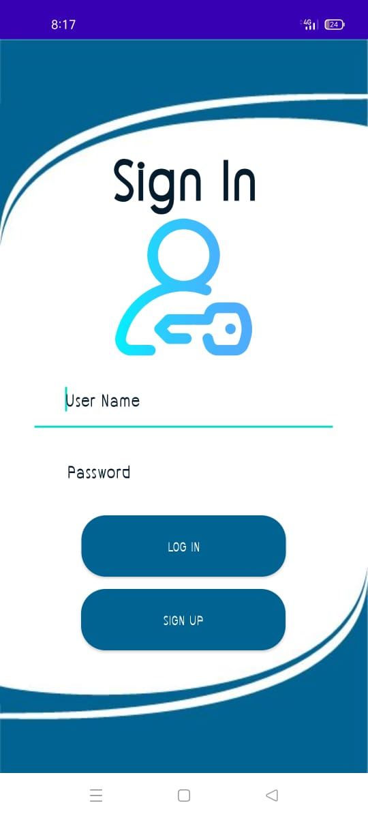
Login Activity
when Registration is Complete a message will be shown that Registration completed, Chairman, Employee and Volunteer can login the application easily by entering their email id and valid password to enter the dashboard for further use.

Slide 11
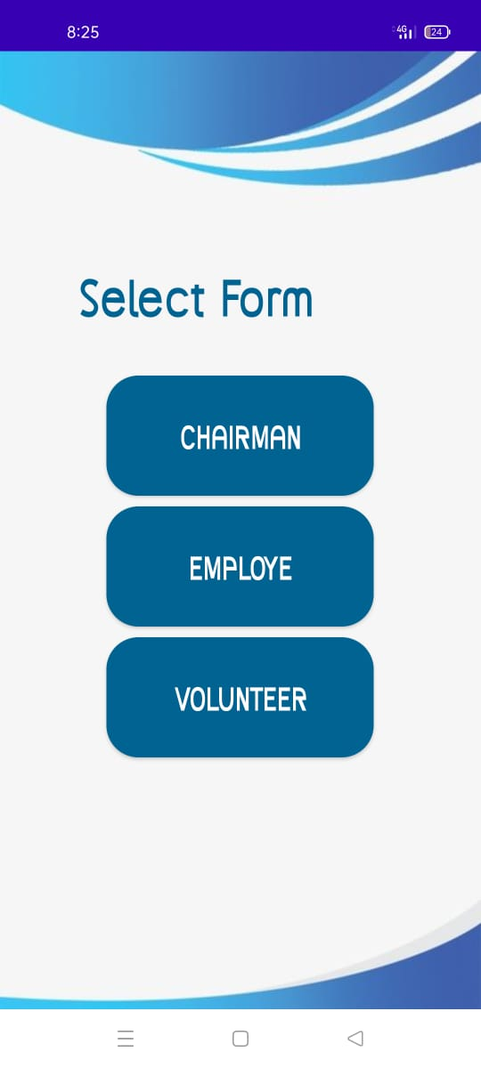
Choose Category for Sign Up
For sign Up in the Clean Pakistan App application you have to choose your category if you are tailor select the tailoring option if you are customer select the customer option.

Slide 12
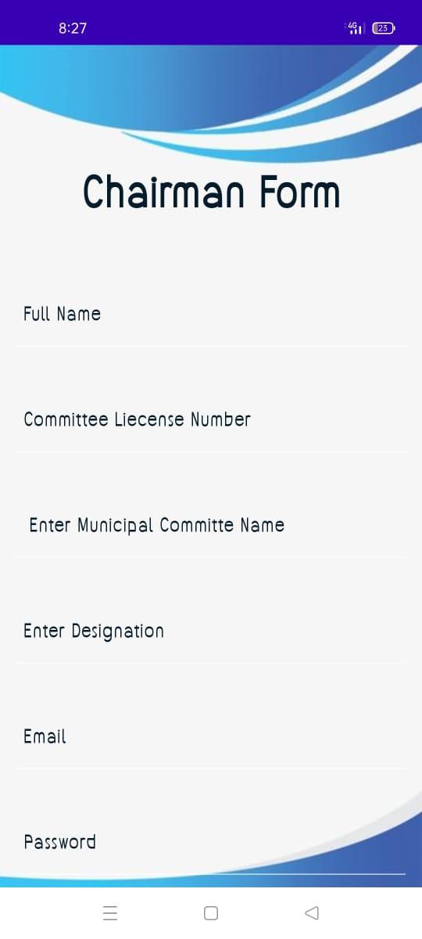
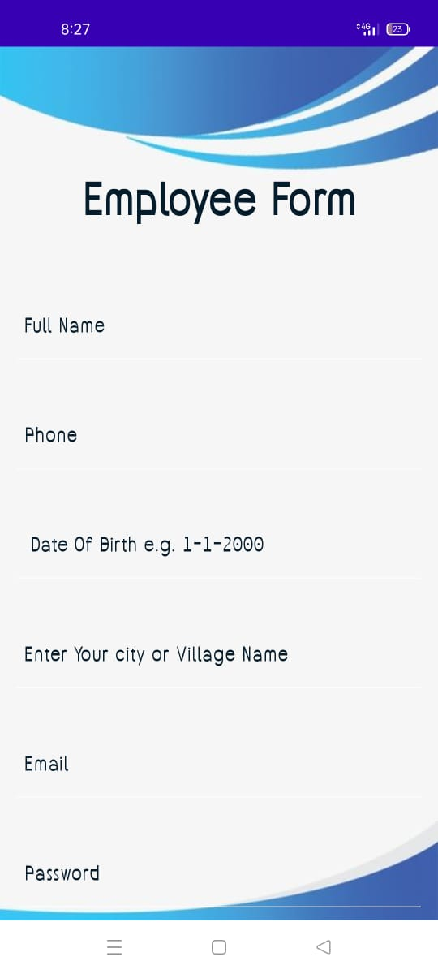
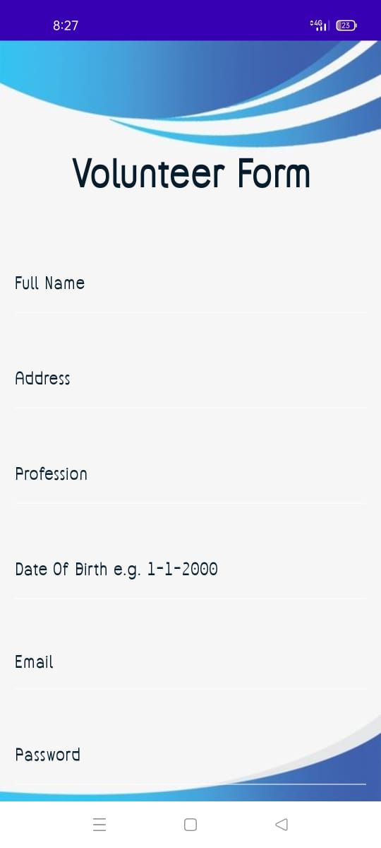
Sign up Activity
TMA Chairman, Employee and Volunteer can be registered in the application by filling the following details.
Chairman Sign Up Activity Employee Sign Up Activity Volunteer Sign Up Activity

Slide 13
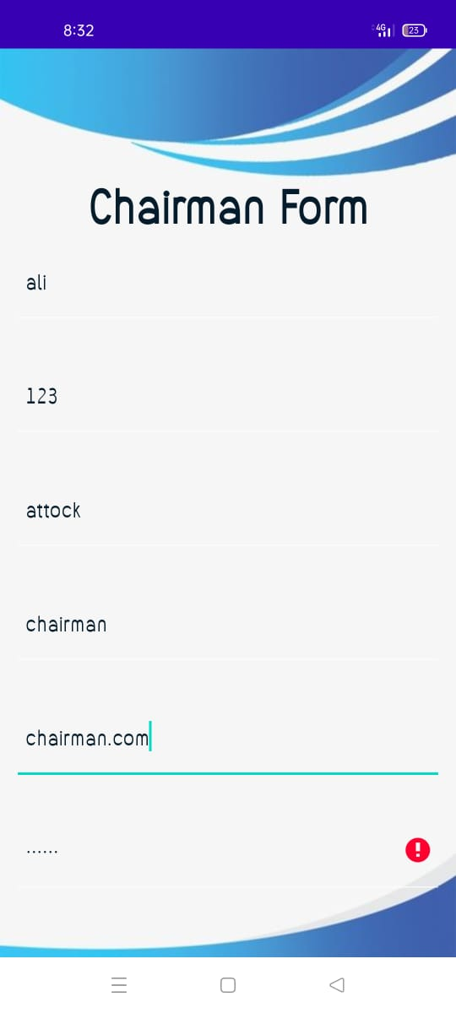
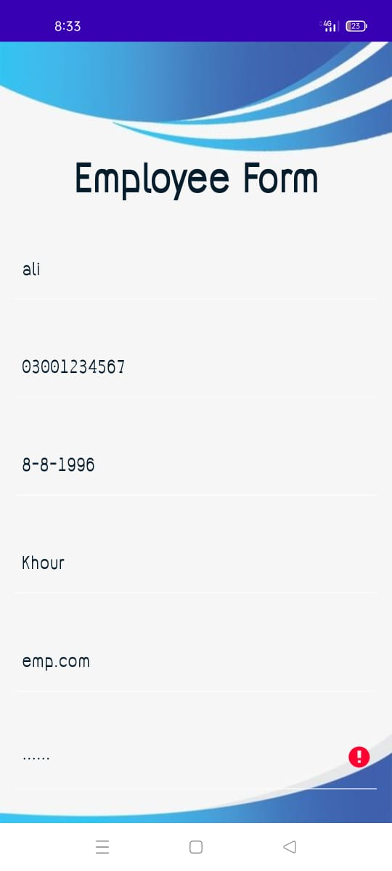
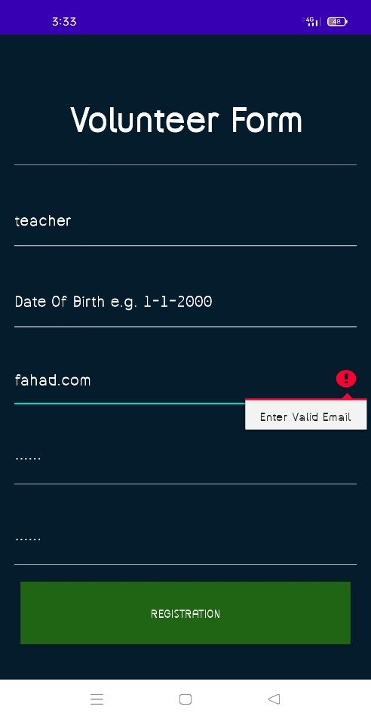
Validation If user click the Login button without enter the Email or Password the application will show error and if the Chairman, Employee or Volunteer miss some fields blank the application will provide error as shown in the below picture.

Slide 14
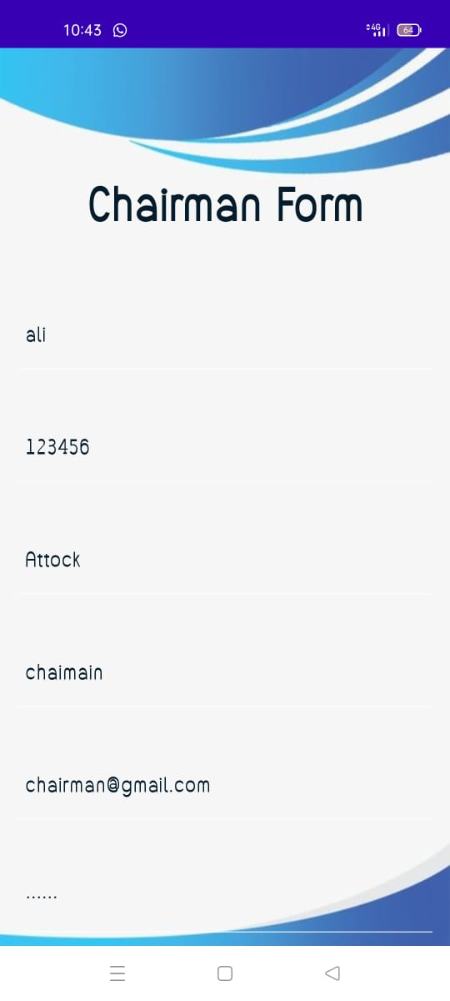
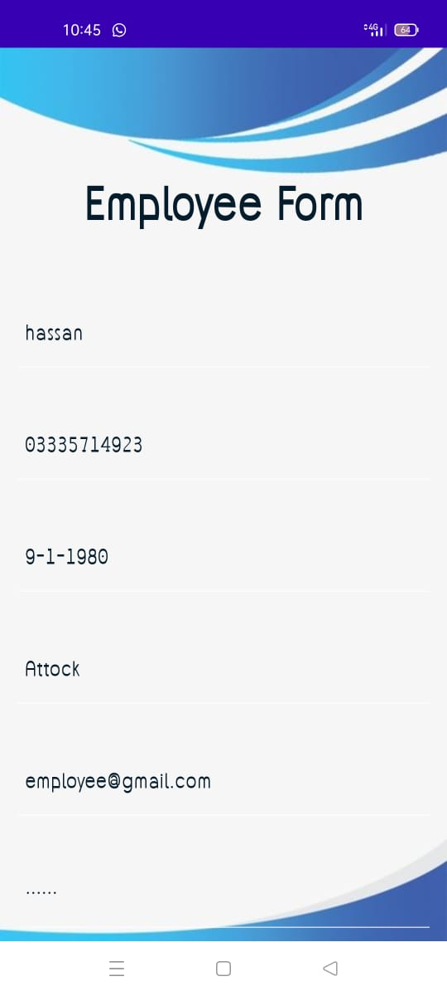
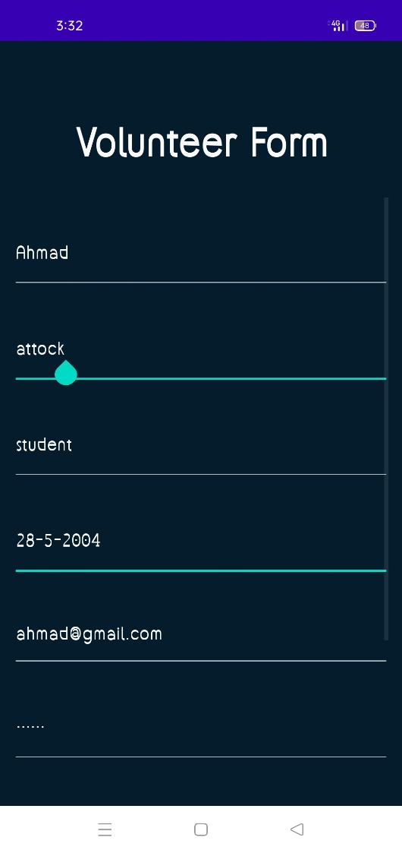
Filling Credentials in the respective fields in the Signup Activity.
Filling Credentials as a Chairman Filling Credentials as a Employee Filling Credentials as a Volunteer

Slide 15
Login Activity
when Registration is Complete a message will be shown that Registration completed, Chairman, Employee and Volunteer can login the application easily by entering their email id and valid password to enter the dashboard for further use.

Slide 16
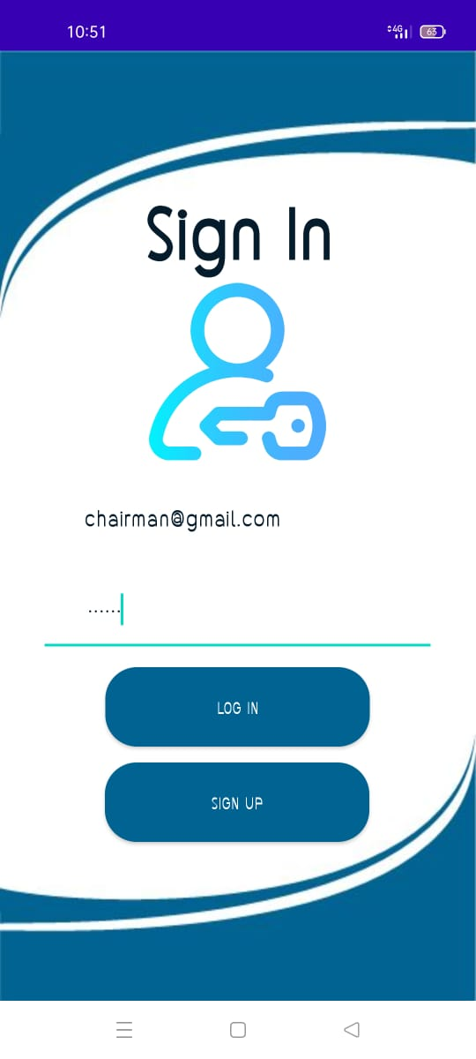


Login Activity
when Registration is Complete a message will be shown that Registration completed, User and tailor can login the application easily by entering their email id and valid password to enter the dashboard for further use.
Registration Completed

Slide 17
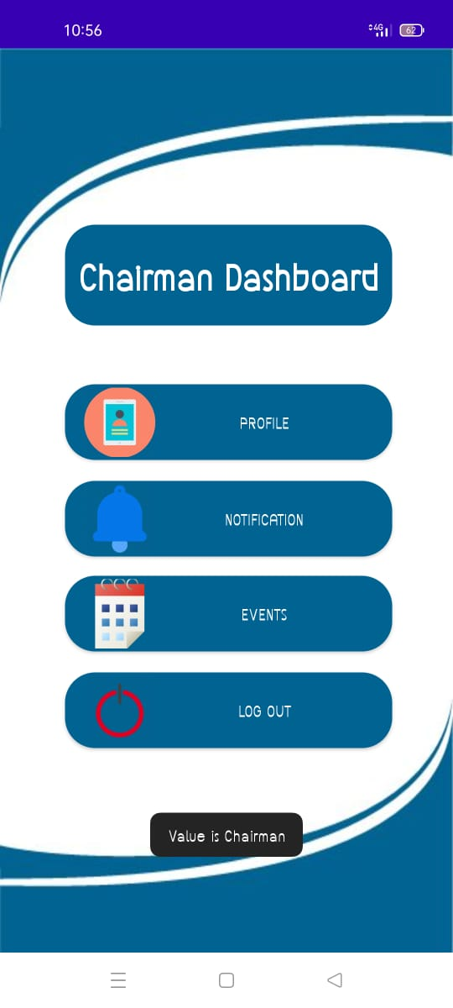
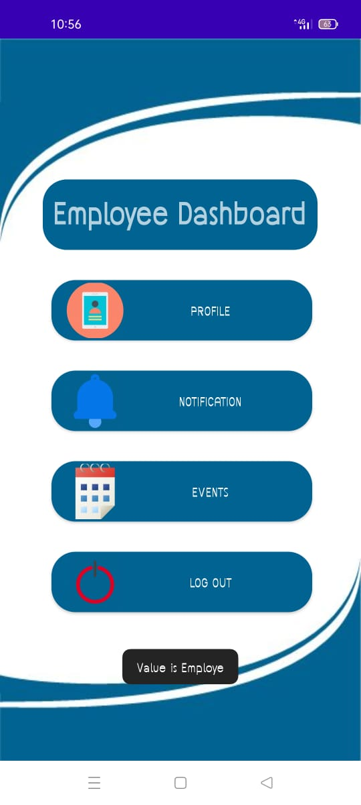
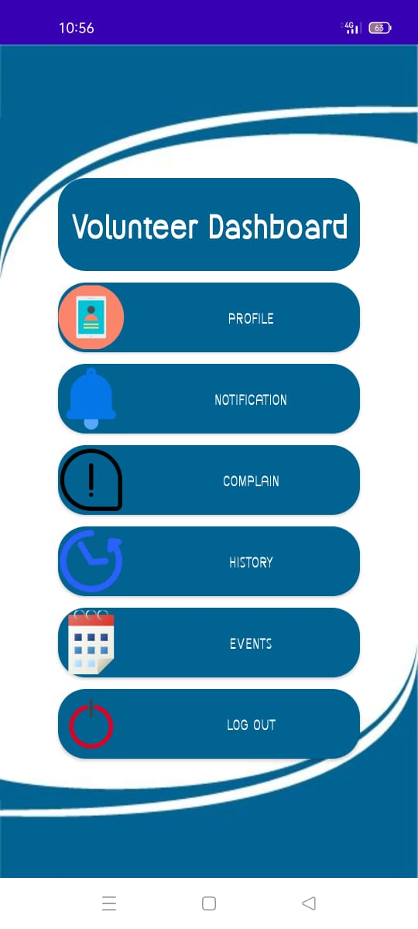
Dashboard
By entering the Related account details Chairman, Employee and Volunteer can enter in their dashboard.
Chairman Dashboard Employee Dashboard Volunteer Dashboard

Slide 18
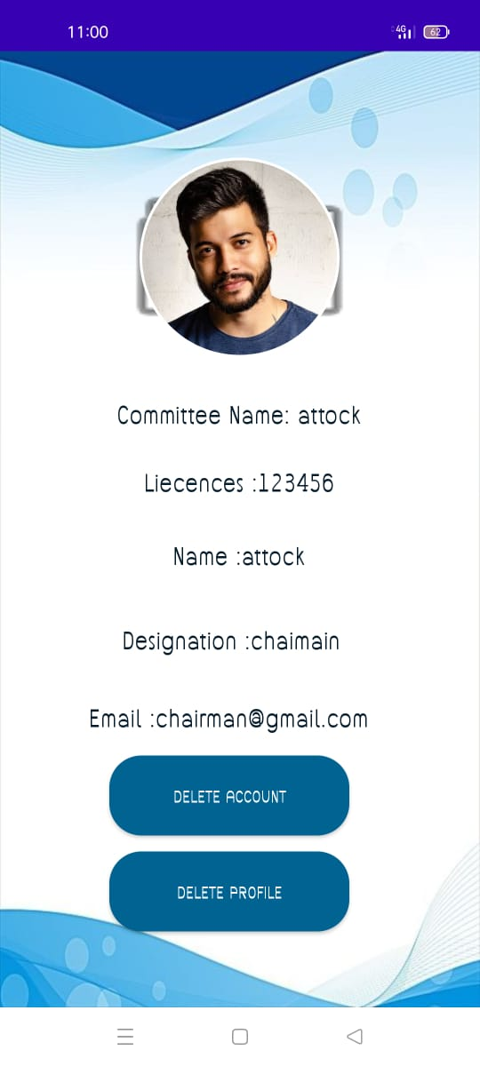
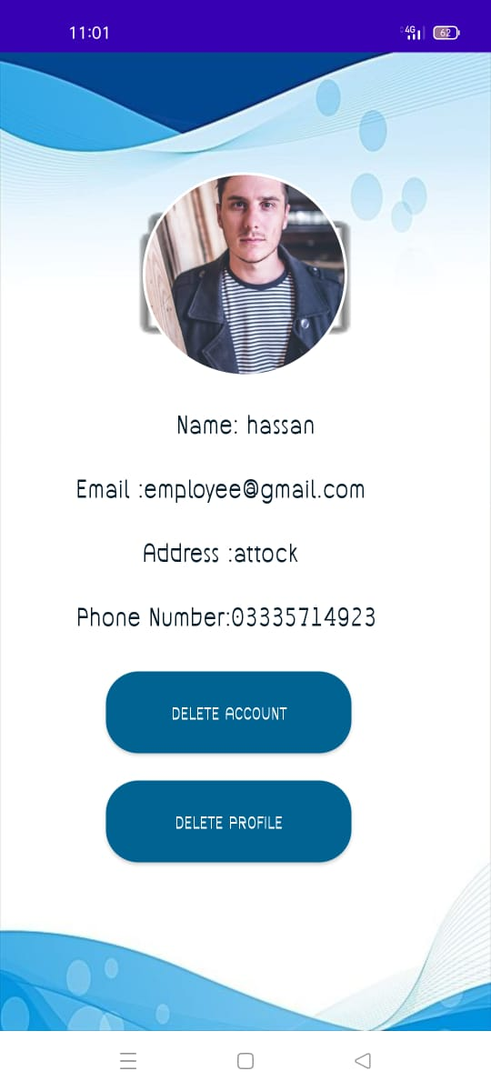
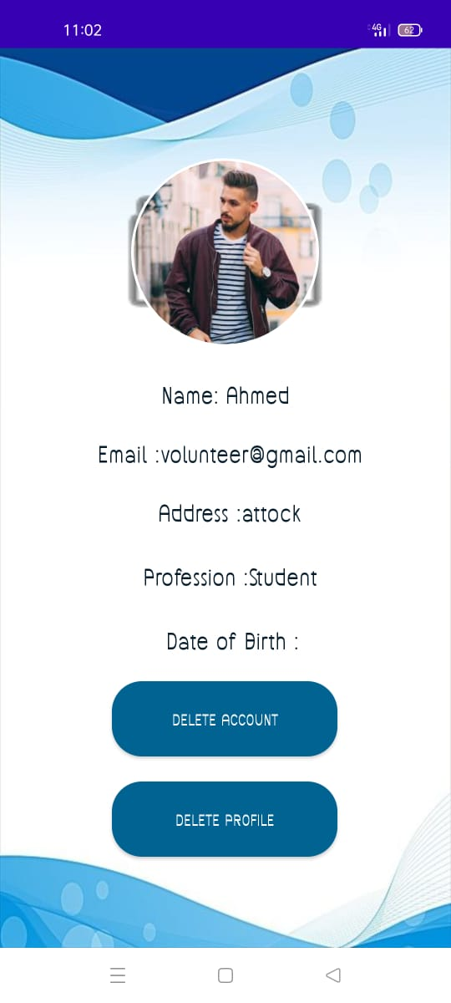
Profile Management
By Tapping the Profile option TMA Chairman, Employee and Volunteer can easily check their details and they can also upload their profile picture .

Slide 19
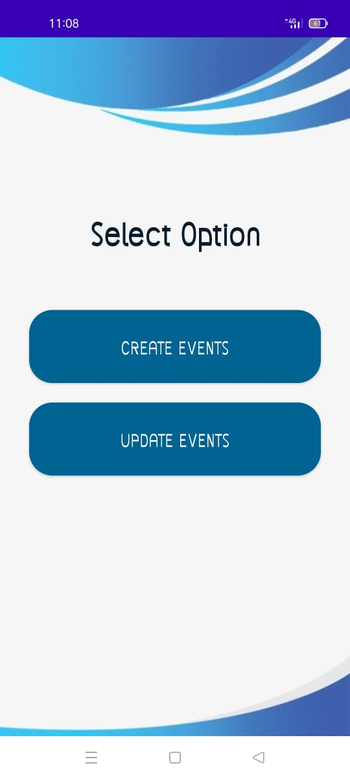
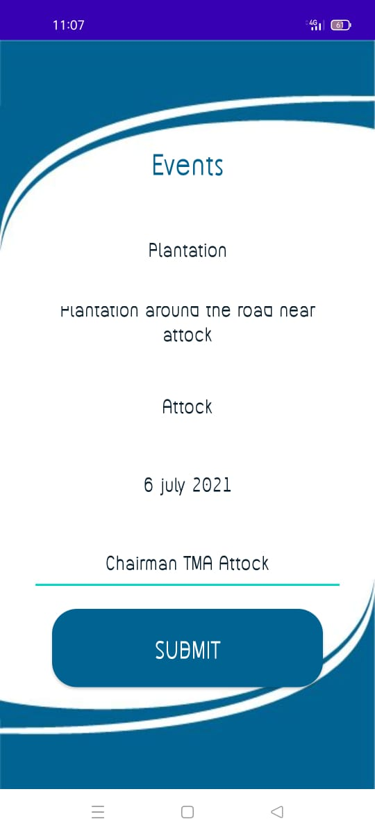
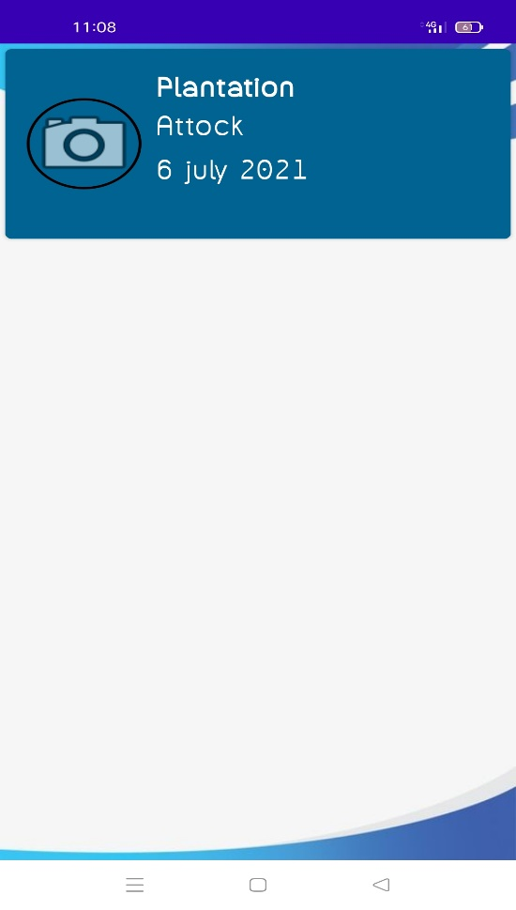
Events
The chairman will create event when any special campaign is started.

Slide 20
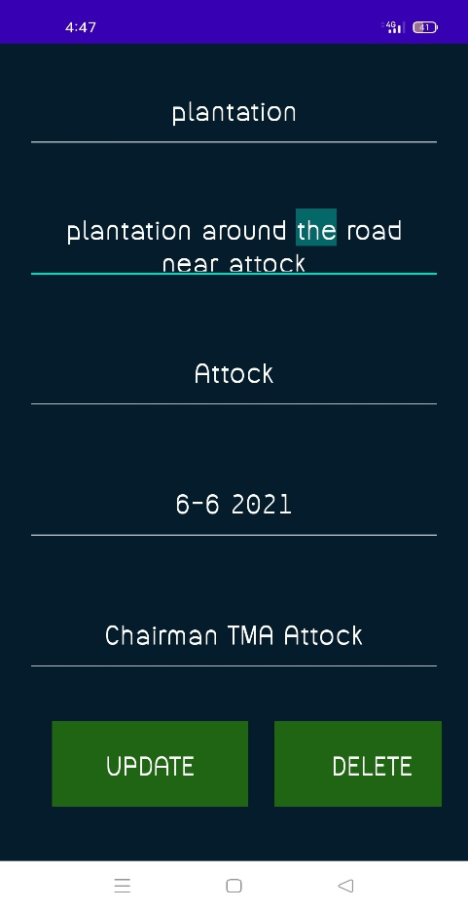
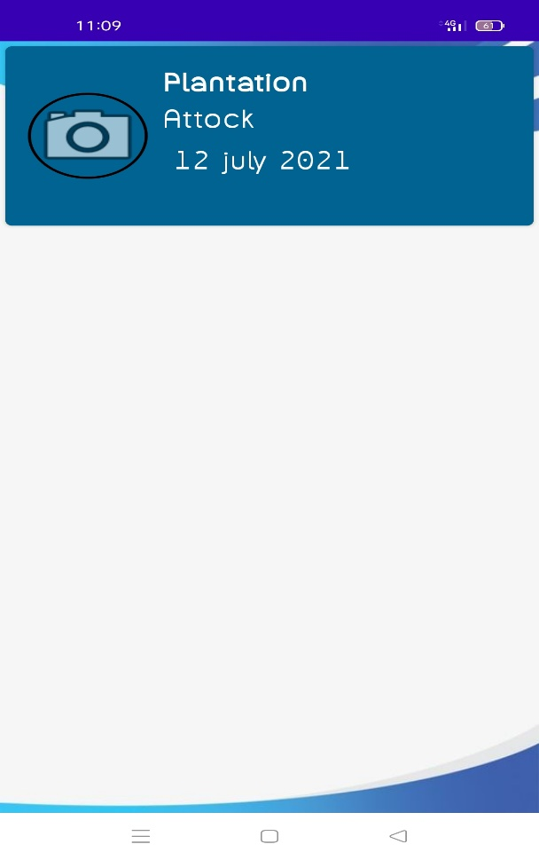
Events (Update)
The chairman will update the event if any changing is needed. In this figure date is updated.

Slide 21
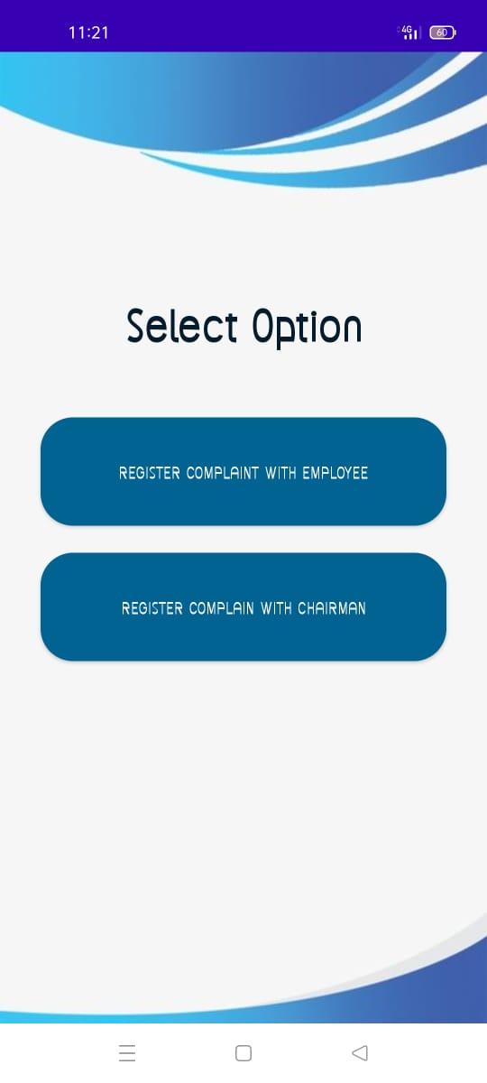
Complain
Volunteer can complain to the employee and Chairman. First he click on complain button on dashboard and select the option

Slide 22
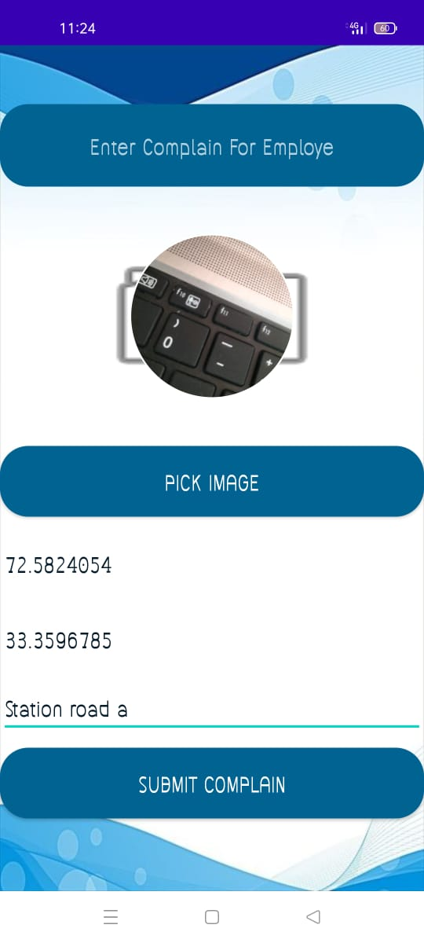
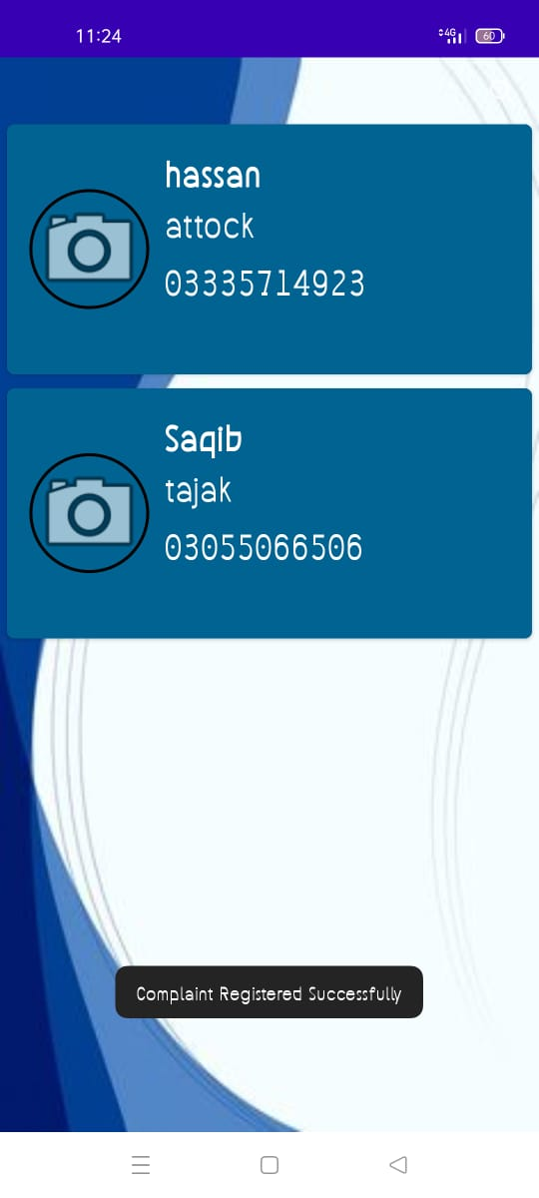
Complain with Employee
If volunteer want to complain to employee he select the employee from list and fill all detail that require for complain

Slide 23
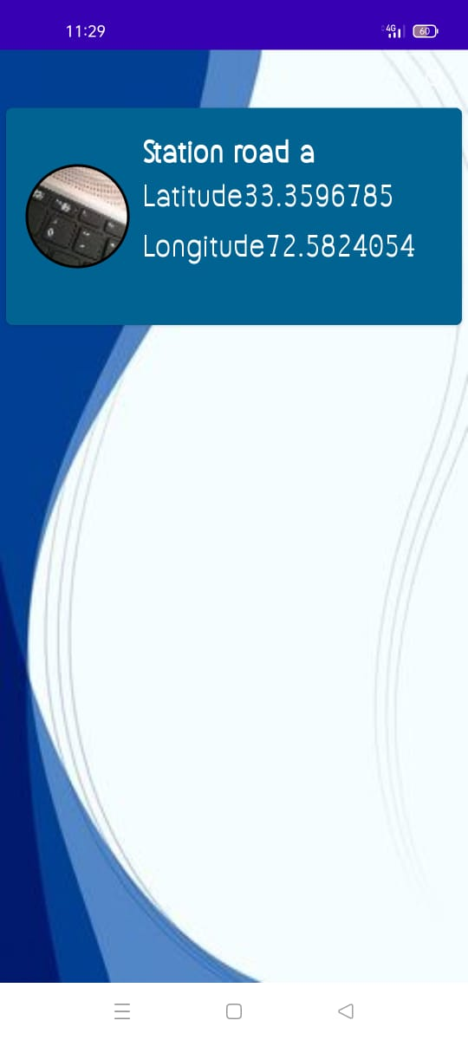
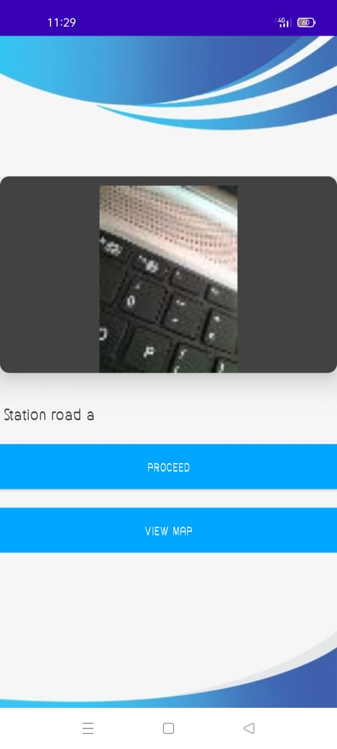
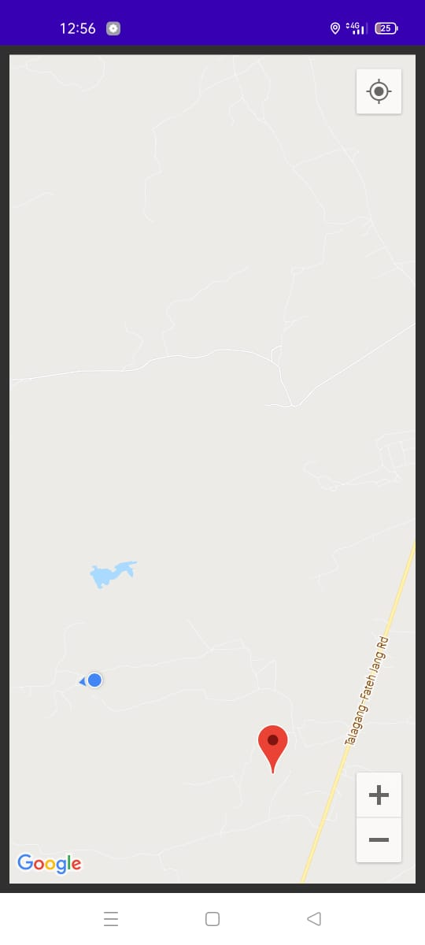
Complain Received to Employee
The Employee will see the list of complain then open the complain check location on the map when he complete then he will click on proceed.

Slide 24
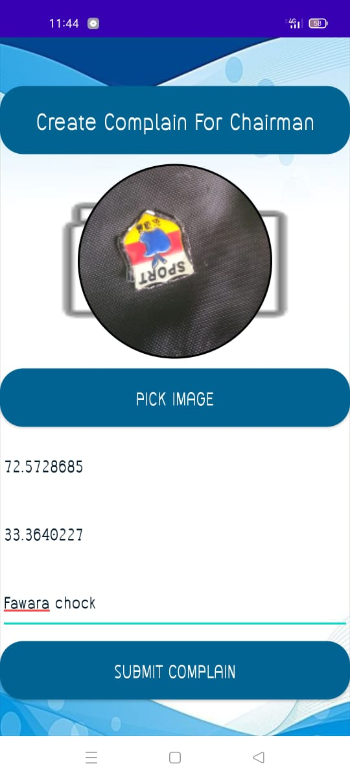
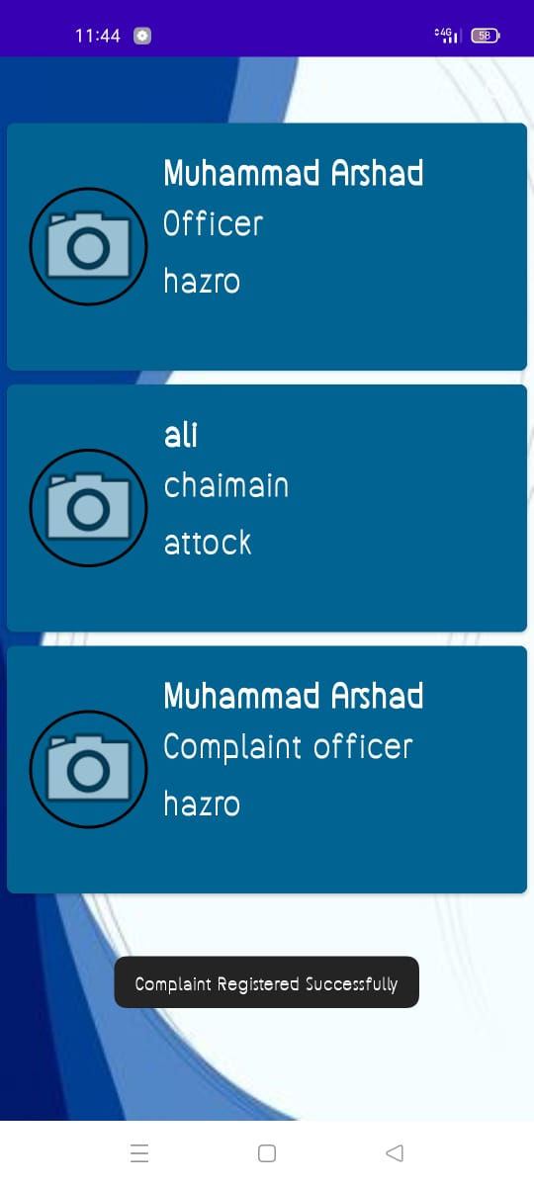
Complain with Chairman
If volunteer want to complain to Chairman he select the Chairman from list and fill all detail that require for complain

Slide 25
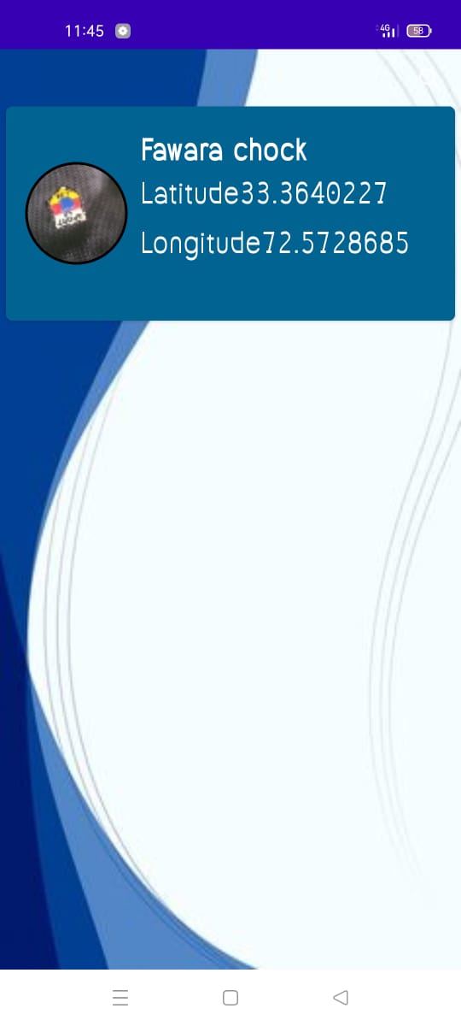
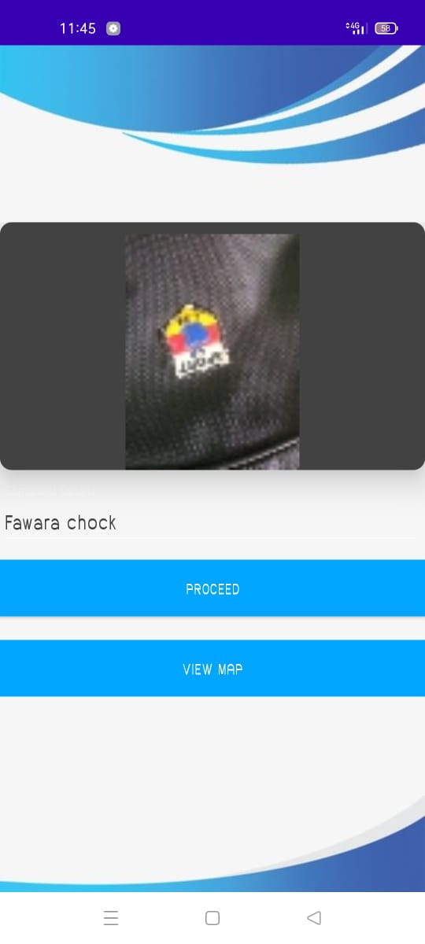
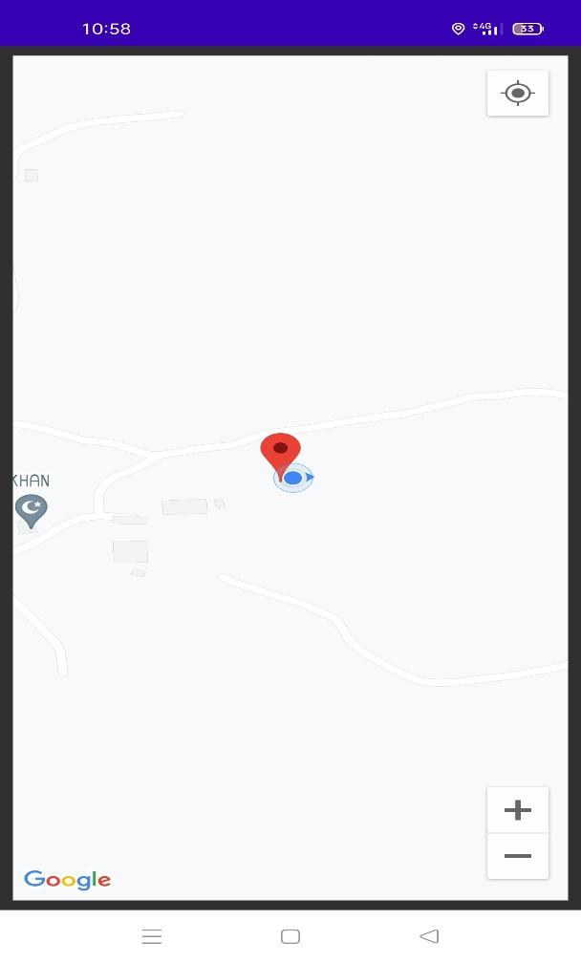
Complain Received to Chairman
The Employee will see the list of complain then open the complain check location on the map when he complete then he will click on proceed.

Slide 26
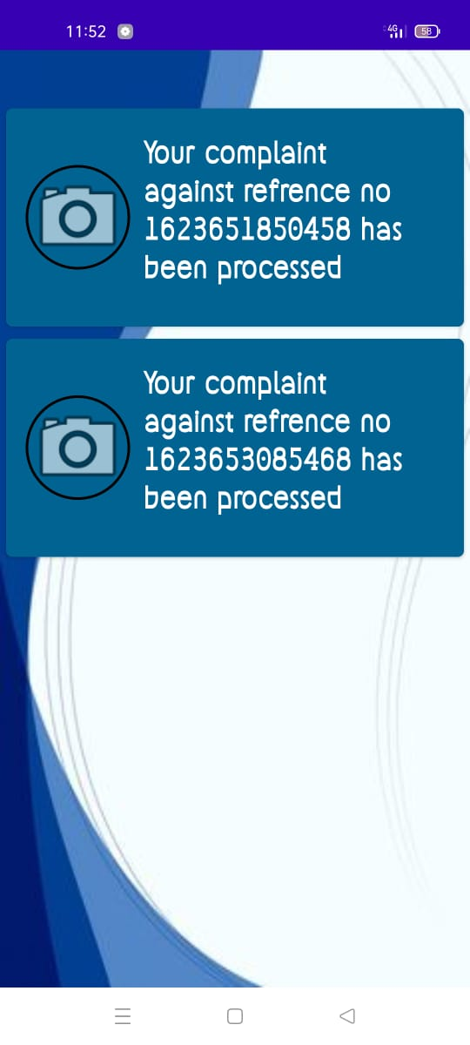
Proceed Notification
When the work complain is completed then a proceed notification is received to Volunteer

Slide 27
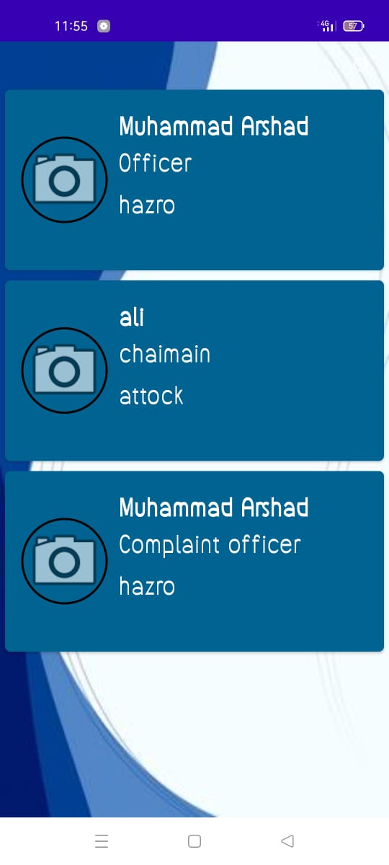
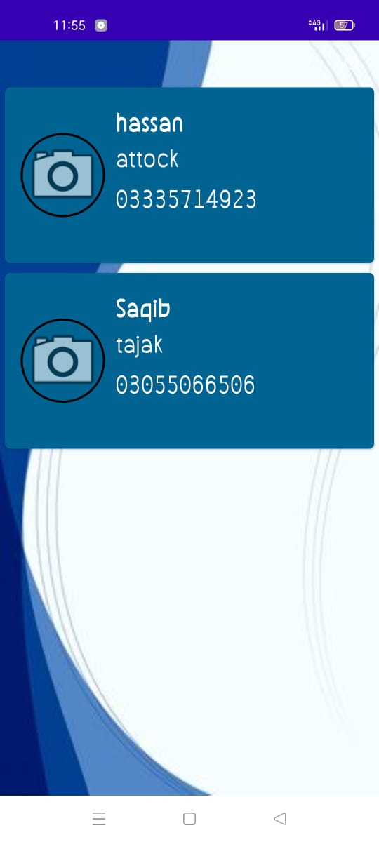
List of Municipal Committees and Employees
This shows the list of employees and municipal committee that are registered in the app.
List of Municipal Committees List of Employees

Slide 28
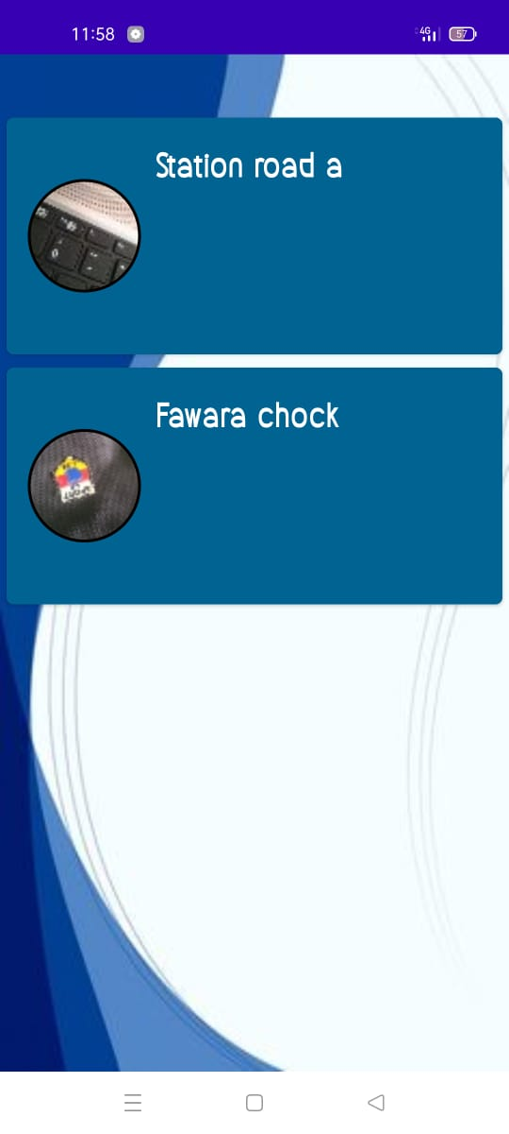
History
This shows the history of the complains that are submitted by the volunteer to both Employee and Chairman.

Slide 29
Logout
If you complete your task and you want to logout your application so you can easily logout your in the application for All TMA Chairman, Employee and Volunteer activity.
Logout from Employee Dashboard

Slide 30
Objectives
Our main goal is to keep the environment clean.
Manage the garbage in efficient way.
To support the government to overcome this problem in Pakistan keep our country clean.
Provide awareness to the Public about garbage and how to handle with them.
This app will improve coordination between government, volunteers and public.

Slide 31
Development Requirements
Software Requirements dependence:
IDE: Android Studio 4.0.1
Programming language: Java, XML.
Database: Firebase
Tools: Android Studio, Notebook,
Hardware Requirements dependence:
Smart Mobile Phone: Android

Slide 32
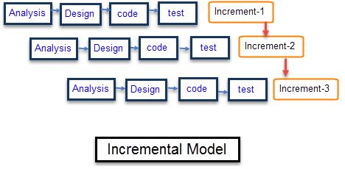
Rationale behind Selected Methodology
Selection of this methodology as we are developing in increments so if changes are required we can change according to our needs.
Using this methodology errors of the system can be identified and removed early and the system will progress without any errors.
During this practice, any suggestion by our supervisor on the working of the system we can easily change and implement.
Test after every increment will ensure the working of the system as if it is working efficiently or not
_______________________________

Slide 33
Modern tools
Tools | Version | Rationale
Android studio | 4.0.1 | IDE
Java development kit | 2018 | Coding
MS Word | 2019 | Documentation
MS Power Point | 2019 | Presentation
Firebase Database | 2019 | For DBMS
Technology | Version | Rationale
Java | 8.0 | For Backend
XML | 6.0 | For Frontend
Smartphone | Android | Testing Purpose
_______________________________

Slide 34
Benefits
The application will serve as a communication link between government and public.
This Application will replace the physical visits or campaign and Mobile Phone message of a government deliver to the public.
App will be user friendly.
Complaint the higher authority of TMA easily.
A common person can provide their job to manage the garbage in their city and town etc.
Provide location to TMA employee to reach this place easily.
_______________________________

Slide 35
Benefits
When government will start specific campaign like billion tree tsunami, any plantation campaign and clean and green Pakistan the unemployed people can get jobs by registering themselves.
This app will automatically record the history of the volunteers who can take part in any activity and will be helpful for the future events.
TMA officers will check the working of their employees.
The people who want to work voluntary have a platform to work by using this app.
_______________________________

Slide 36
References
https://en.wikipedia.org/wiki/Android_software_development
https://ukdiss.com/examples/e-tailing-2.php
https://medium.com/@epitomestitches1/advantages-of-online-tailoring-that-you-should-consider-38c215b6508c
_______________________________

